Slide 1



NITK-CMU JOINT WINTER SCHOOL IPTSE MULTIMEDIA ANALYSIS
DHRUV GOEL JINANK JAIN SKAND ARORA SATISH

Slide 2
TEXT BASED EMOTION RECOGNITION SYSTEM
Some of the common emotions we express in our daily lives include Joy, Happiness, Fear, Sadness, Surprise, Anger and so on.
Emotional state of a person can be recognized by:
Speech
Facial expressions
Text

Slide 3
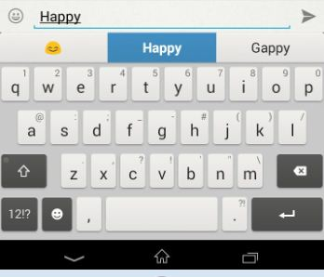
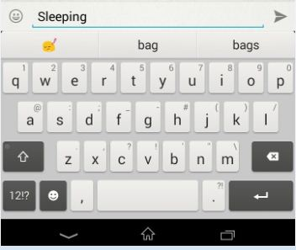
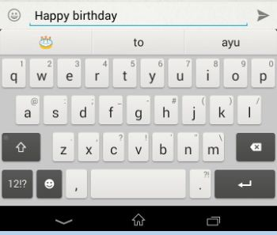

Slide 4
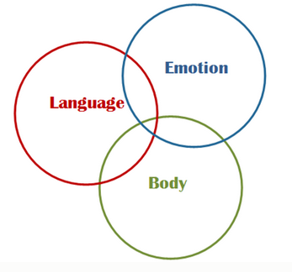
EMOTION ONTOLOGY
An ontology defines a set of class with which to model a domain of knowledge.
In emotion ontology we have 8 different classes:
Joy
Anger
Sadness
Fear
Surprise
Trust
Disgust
Anticipate

Slide 5
IMPLEMENTATION
What are the emotions we are interested in?
How to collect the input dataset?
How to process and find the emotion?

Slide 6
KEYWORD EXTRACTION
Identify keywords that are the useful to the classifier from the input dataset.
POS Tagger: Part-of-Speech Tagging
Limitations:
Ambiguity in keyword definitions
Incapability of recognizing sentences without keywords
Lack of linguistic information

Slide 7
PROPOSED SYSTEM
INPUT TEXT OUTPUT TEXT
EMOTION DETECTOR
EMOTION WORD ONTOLOGY

Slide 8
FUTURE SCOPE
Unstructured slang language
Analyzing data for chatting
Advanced emotions
Text Categorization

Slide 9
ISOLATING DESIRED INSTRUMENTS IN MUSIC
Blind Signal Separation: Separating different signals from a set of mixed signals.
Identification of different signals i.e. instruments and the vocalist(if any).
User input
Eliminating undesired signals i.e. instruments or the vocalist.

